Slide 1

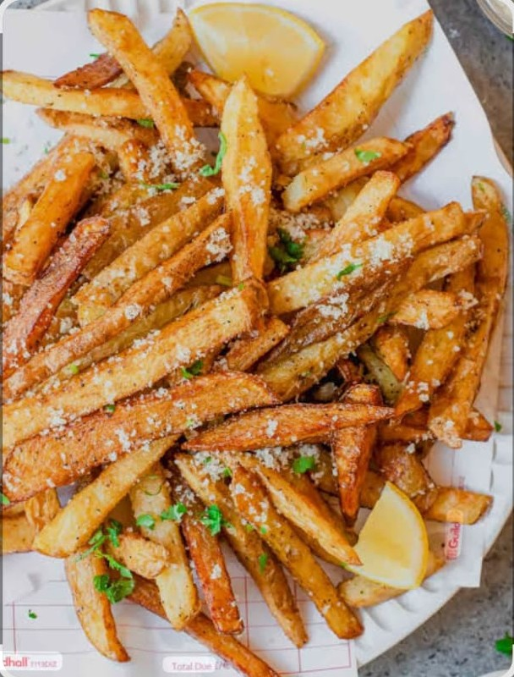
Cyclox - Online Food Ordering System🧑‍🍳🥘
SQL Case Study Project
_____________________________
Vineet Jena

Slide 2
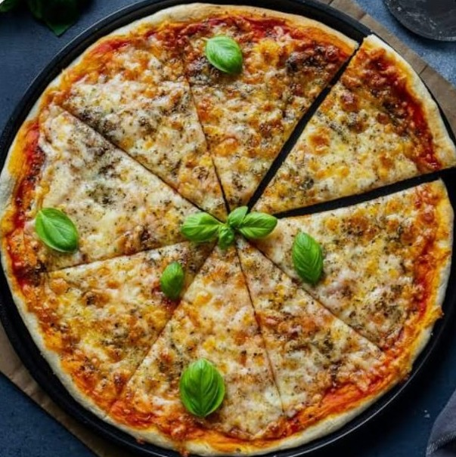
|Project Overview
To Analyze Online Food Ordering Data Using SQL To Gain Insights On Feedbacks, Most Ordered, Top Rated and Order History.
Tools : SQL (MySQL) , Excel
Focus Areas :
Top-rated restaurants
Most ordered items
Customer order history
Total revenue
Customer feedback

Slide 3
|Dataset Summary
Customers Table : CustomerID, FirstName, LastName, Email, Phone, RegistrationDate
Restaurants Table : RestaurantID, RestaurantName, Address, CuisineType
Menu Items Table : MenuItemID, RestaurantID, ItemName, Price, Description
Orders : OrderID, CustomerID, RestaurantID, OrderDate, TotalAmount
OrderDetails Table : OrderDetailID, OrderID, MenuItemID, Quantity, ItemPrice
Reviews Table : ReviewID, RestaurantID, CustomerID, ReviewDate, Rating, Comments

Slide 4
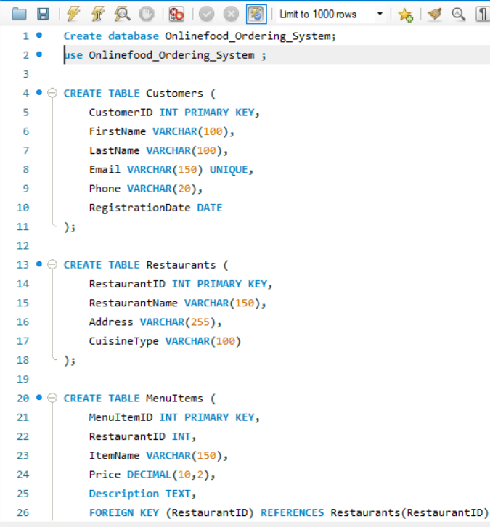
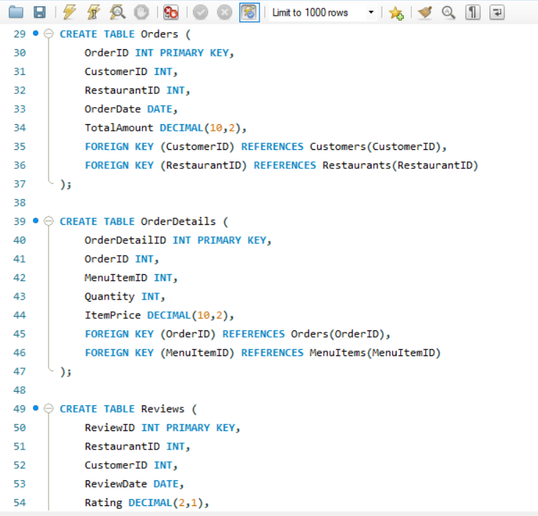
| Database And Table Creation

Slide 5
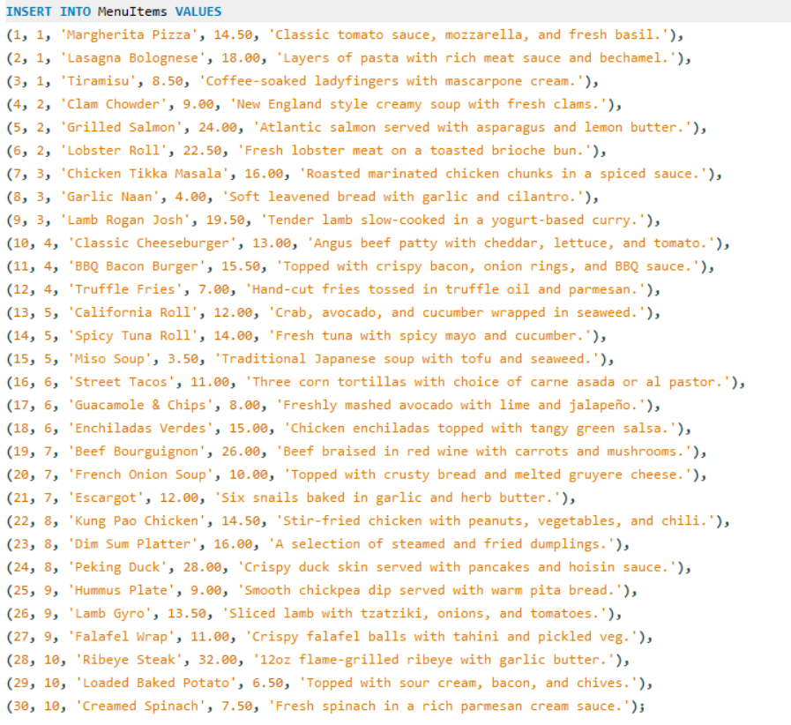
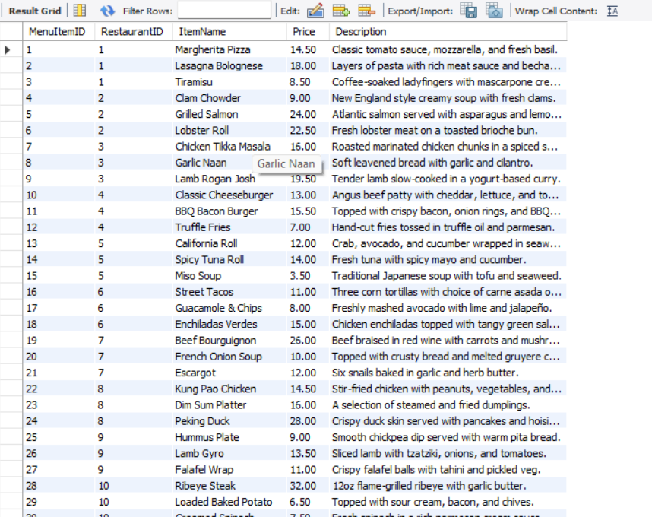
|Inserted Data

Slide 6

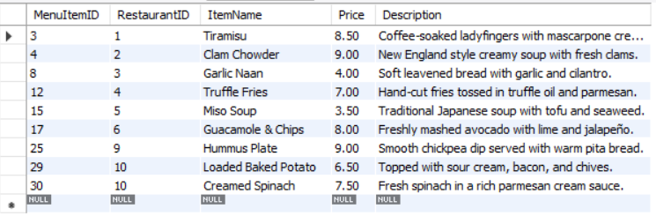
|All menu items where the price is less than $10

Slide 7
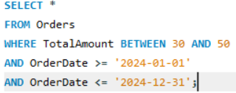
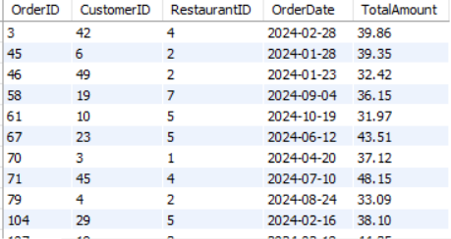
|All orders where the total amount is between $30 and $50 and the order date is in 2024.

Slide 8


|All restaurants where the cuisine type contains 'Italian'.

Slide 9
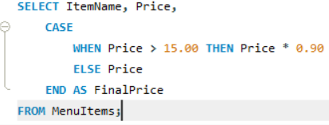
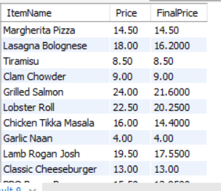
|Item names and discounted price if the original price is greater than $15.

Slide 10
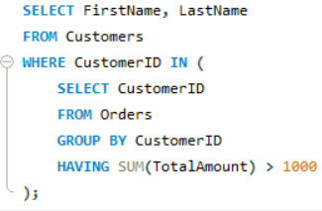
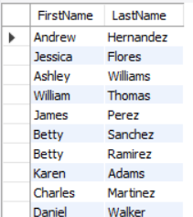
|All customers who have placed orders totaling more than $1000.

Slide 11

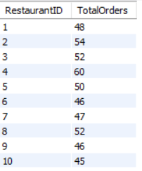
|Total number of orders placed at each restaurant

Slide 12
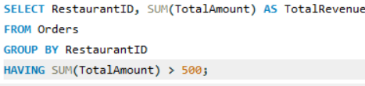
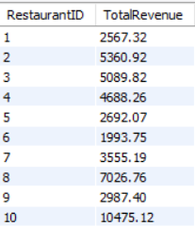
|Total amount of orders for each restaurant along with totals greater than $500.

Slide 13
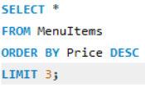
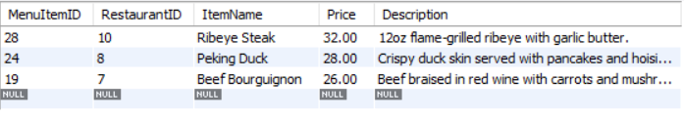
|Top 3 most expensive menu items

Slide 14

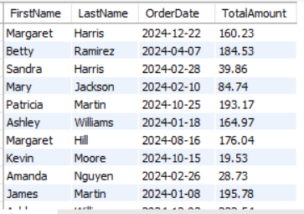
|All orders with customer names, order dates, and total amounts

Slide 15

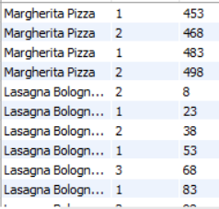
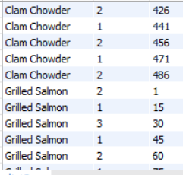
|All menu items and associated order details with items that might not have been ordered

Slide 16
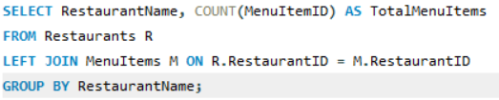
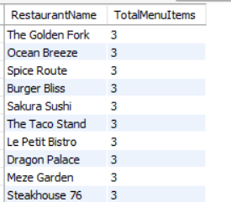
|Total number of menu items available in each restaurant.

Slide 17
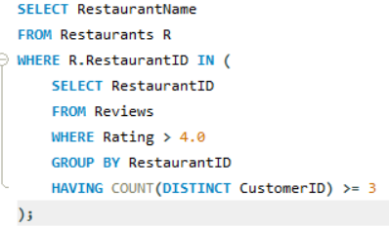
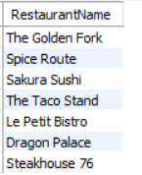
|All restaurants that have a rating of more than 4.0 from at least 3 different customers.

Slide 18
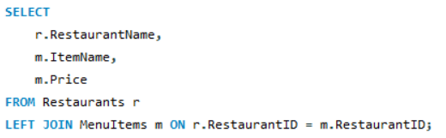
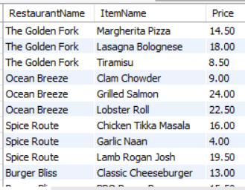
|All restaurants with their menu items including those with no items

Slide 19


